Slide 1

TheIOFoundation.org | Contact@TheIOFoundation | Join.TheIOFoundation.org
Notes:
Contact The IO Foundation
Website https://TheIOFoundation.org
Join TIOF https://TIOF.Click/JoinUs
Github repository https://TIOF.Click/TIOFRepo
Linkedin https://TIOF.Click/TIOFLinkedIn
Twitter https://TIOF.Click/TIOFTwitter
Summary of links https://TIOF.Click/AboutUs
Media Kit https://TIOF.Click/TIOFMediaKit

Slide 2
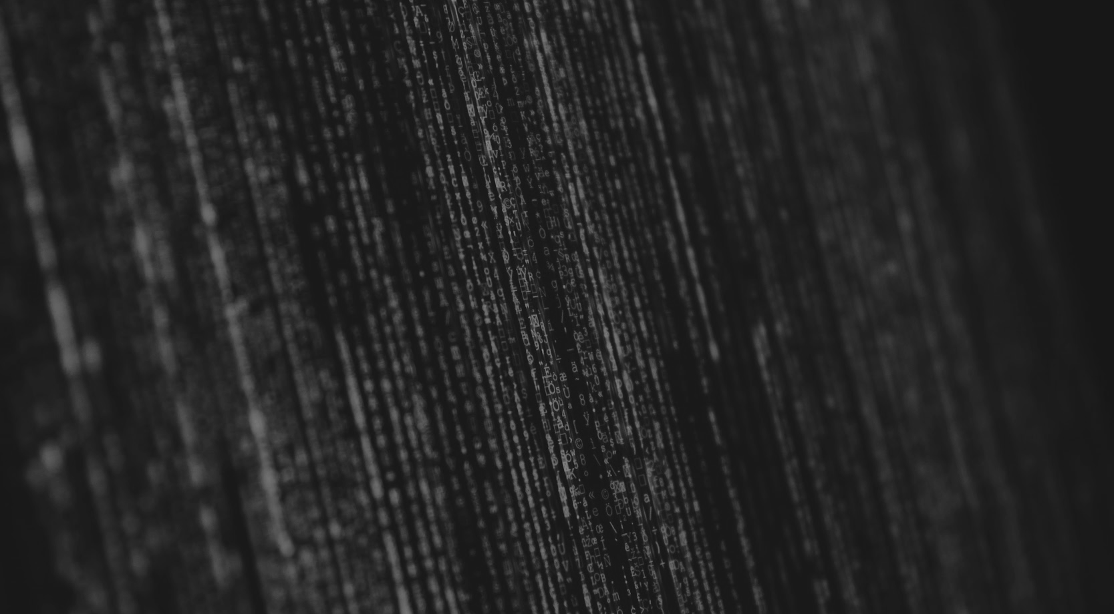

Data-Centric Digital Rights
Protecting your data by design
TheIOFoundation.org | Contact@TheIOFoundation | Join.TheIOFoundation.org

Slide 3

ABOUT THE IO FOUNDATION
The IO Foundation (TIOF) is a global for-impact NGO advocating for Data-Centric Digital Rights to establish a more solid approach to Rights from a technical standards perspective and to raise awareness on the critical role of programmers as the
Next Generation of Human and Digital Rights defenders.
TheIOFoundation.org | Contact@TheIOFoundation | Join.TheIOFoundation.org
Notes:
Note: Links are clickable (on slides too, when applicable).
In summary: Data-Centric Digital Rights advocates to establish the necessary technical standards to transparently implement Digital Rights and enable technologists to create better and safer digital societies by embracing their role as Rights defenders.
The IO Foundation focuses its efforts towards programmers and in the proclamation of a Universal Declaration of Digital Rights.
General info: https://TIOF.Click/AboutUs
OrgChart: http://TIOF.Click/TIOFOrgChart

Slide 4

AGENDA
Presenting observed challenges
Introduction to the DCDR Framework
Applications of the DCDR Framework
TheIOFoundation.org | Contact@TheIOFoundation | Join.TheIOFoundation.org

Slide 5

PART I
THE CURRENT STATE OF AFFAIRS
TheIOFoundation.org | Contact@TheIOFoundation | Join.TheIOFoundation.org

Slide 6

FALLACY
ALL OF YOU A HACKER
TheIOFoundation.org | Contact@TheIOFoundation | Join.TheIOFoundation.org

Slide 7

EXAMINING
THE CAR INDUSTRY
TheIOFoundation.org | Contact@TheIOFoundation | Join.TheIOFoundation.org
Notes:
Assumptions:
Due to the complexity of the subject, citizens:
Rely on governments to protect them
Cars are given safe
Citizens are responsible for the use

Slide 8
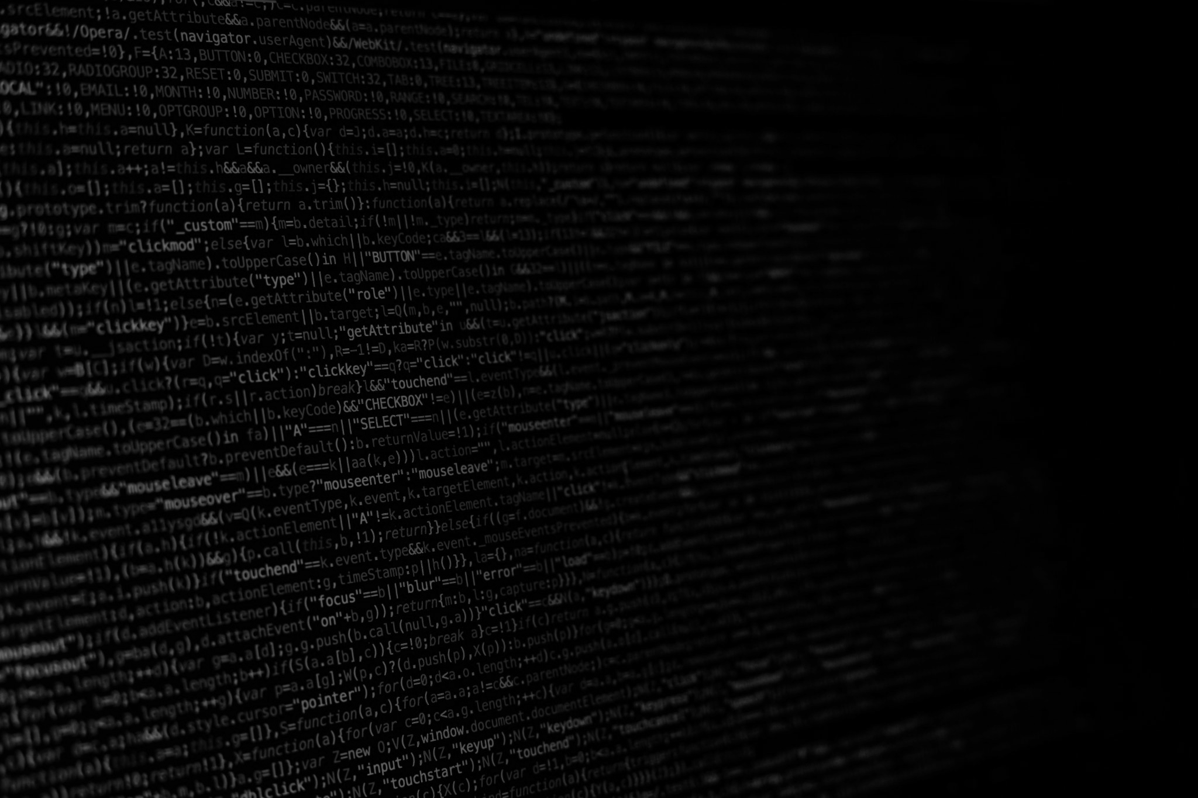
COMPONENTS OF ANY PRODUCT
COMPLIANCE
(Rights go here)
VALUE
PROPOSITION
TheIOFoundation.org | Contact@TheIOFoundation | Join.TheIOFoundation.org
Notes:
Life, in the same comparison, has broadly the same compartments:
- Survival and basic comfort
- Additional services
Companies should concentrate on offering value propositions
Governments should concentrate on ensuring Part 1 is implemented
Reference to BHR?

Slide 9
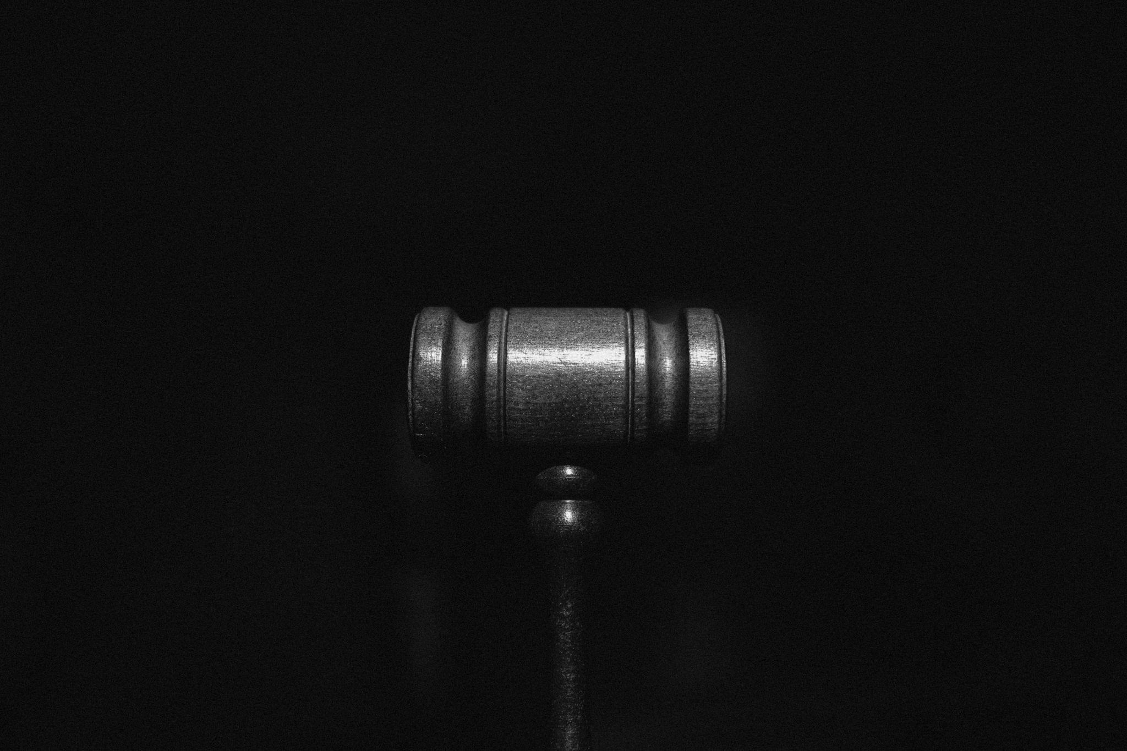
PROBLEM
DATA PROTECTION LAWS
TheIOFoundation.org | Contact@TheIOFoundation | Join.TheIOFoundation.org
Notes:
- Data in sovereign territory

Slide 10
CROSS-JURISDICTION PROTECTION
JURISDICTION
A
JURISDICTION
B
JURISDICTION
C
TheIOFoundation.org | Contact@TheIOFoundation | Join.TheIOFoundation.org
Notes:
Lack of minimum common denominator

Slide 11

The nature
of data
TheIOFoundation.org | Contact@TheIOFoundation | Join.TheIOFoundation.org
Notes:
11 different definitions, so far.
No international agreement about WHAT IS DATA.

Slide 12

PROGRAMERS
NEXTGEN RIGHTS DEFENDERS
TheIOFoundation.org | Contact@TheIOFoundation | Join.TheIOFoundation.org

Slide 13
CORE PROBLEMS
ALGORITHMIC ANSWER TO THE PROBLEM
SENSE OF PURPOSE
TheIOFoundation.org | Contact@TheIOFoundation | Join.TheIOFoundation.org
Notes:
What do we need to make them be the NEXTGEN?

Slide 14

“I’d love to change the world
but
they won’t give me the source code.”
Some genius
TheIOFoundation.org | Contact@TheIOFoundation | Join.TheIOFoundation.org
Notes:
Note: Links are clickable (on slides too, when applicable).
Best nerd joke ever.
Only it’s not that much of a joke.

Slide 15
PART II
THE DCDR FRAMEWORK
TheIOFoundation.org | Contact@TheIOFoundation | Join.TheIOFoundation.org

Slide 16
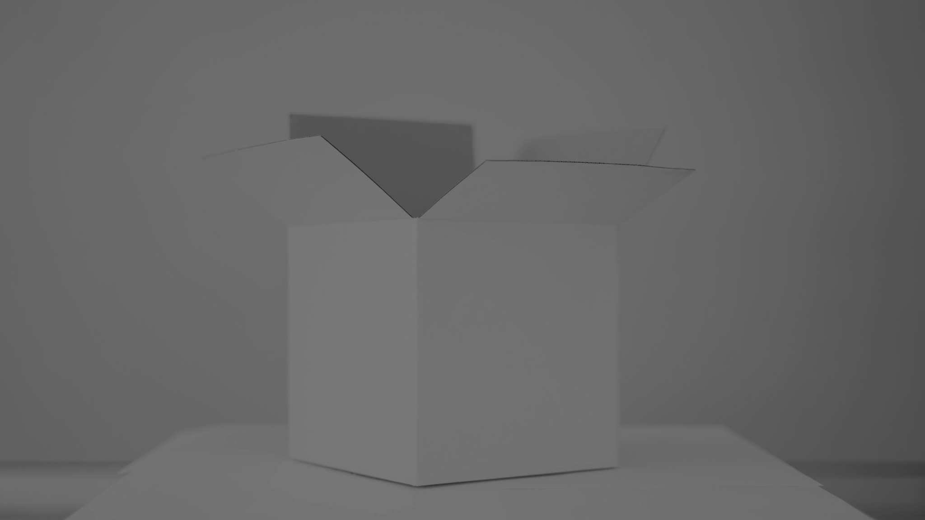
UNPACKING THE DCDR FRAMEWORK
- SET OF PREMISES
- STRUCTURED DATA LIFECYCLE
- STRUCTURAL LAYERS
- TAXONOMIES
- PRINCIPLES
- SAGAN OATH
- IMPLEMENTATION TIMELINE
- DR SDK MVP
- SET OF STAKEHOLDERS
- POLICY GUIDELINES
- PEDAGOGICAL MATERIALS
- FINANCIAL MODELS
- MESSAGING STRATEGIES
TheIOFoundation.org | Contact@TheIOFoundation | Join.TheIOFoundation.org
Notes:
1 Public Messaging
(Messaging depending on the Adoption Phase? Early Adopters, etc.)

Slide 17

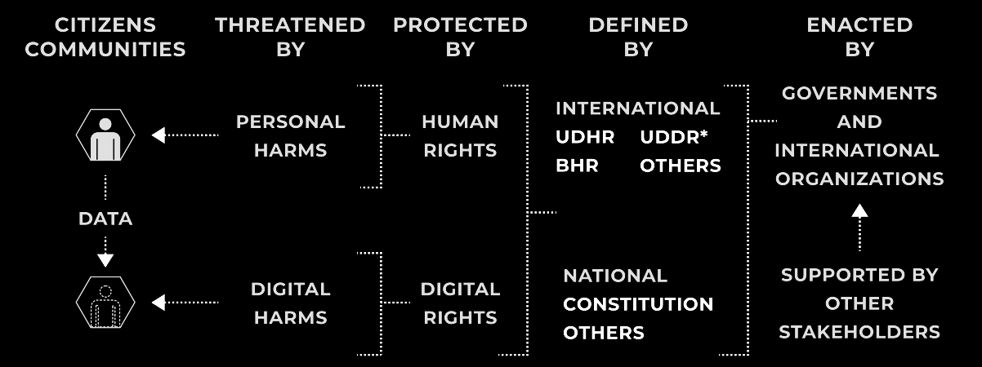
PHYSICAL vs DIGITAL
TheIOFoundation.org | Contact@TheIOFoundation | Join.TheIOFoundation.org
Notes:
Note: Links are clickable (on slides too, when applicable).
To understand both the similarities and differences between Human Rights and Data-Centric Digital Rights, it is important to establish the core element to protect.
In Human Rights, it is people.
In Data-Centric Digital Rights, it’s data.
It is then possible to establish:
What are the Digital Harms that can affect data.
What are the Digital Rights that need to be established to proactively avoid said harms.
This enables the necessary understanding and common language that can be taught to technologists to protect digital citizens through their data.

Slide 18

DCDR CORE PREMISES
(A summary)
- I AM MY DATA
- CORE OBJECTIVE: EXTENDING THE LIFECYCLE OF ANY ENTITY OVER TIME
- HARMS SHORTEN LIFECYCLE
- RIGHTS ARE THE PROACTIVE ATTEMPT TO AVOID HARMS
TheIOFoundation.org | Contact@TheIOFoundation | Join.TheIOFoundation.org
Notes:
THE WHY

Slide 19

DCDR FRAMEWORK
DIGITAL TWINS
TheIOFoundation.org | Contact@TheIOFoundation | Join.TheIOFoundation.org

Slide 20
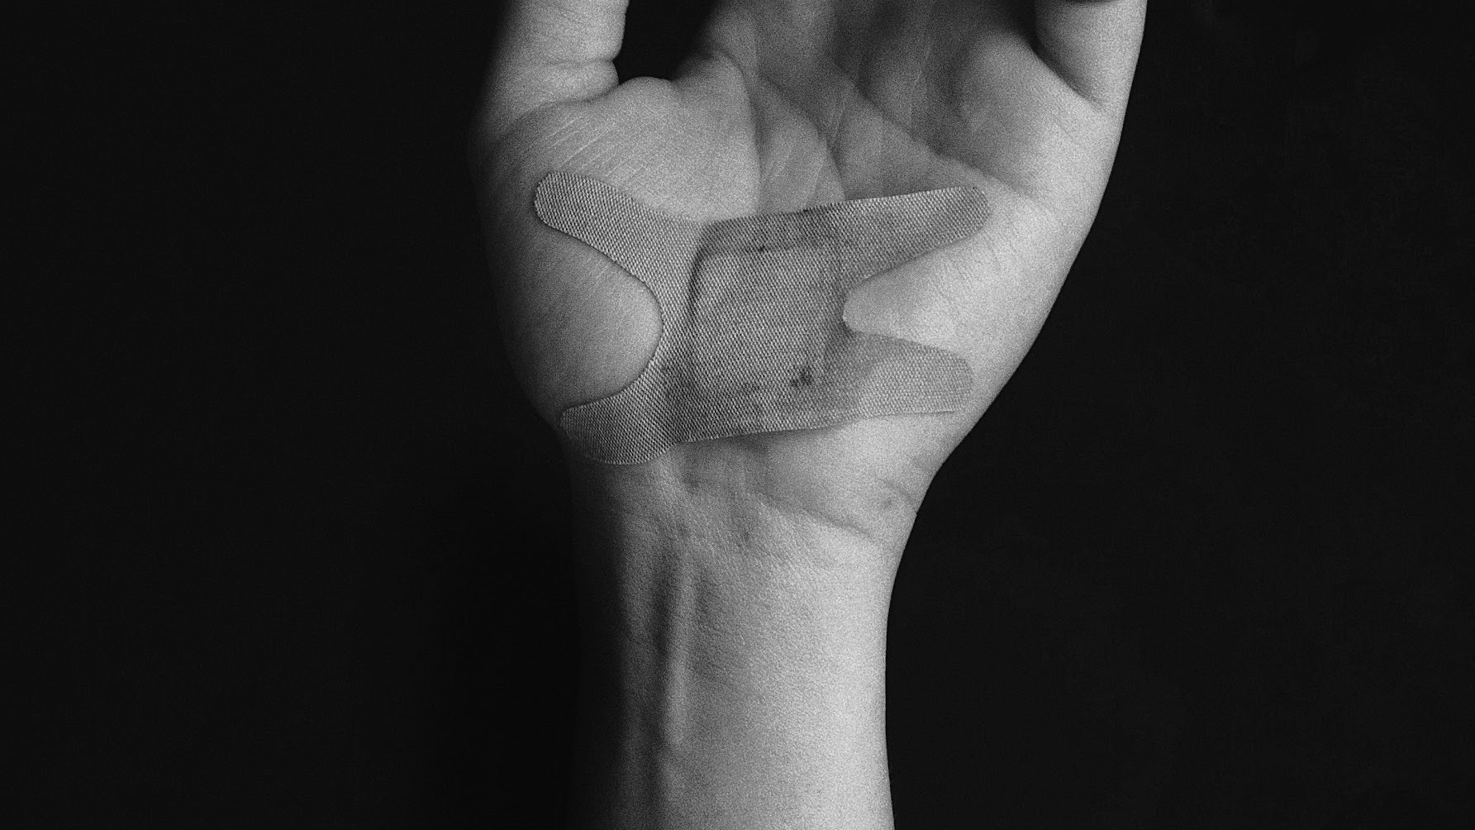
TERMINOLOGY
PHYSICAL HARM
Any harm received by
a physical entity.
TheIOFoundation.org | Contact@TheIOFoundation | Join.TheIOFoundation.org
Notes:
A harm is caused/inflicted when a Right is not observed.
Ultimate Harm = Death

Slide 21
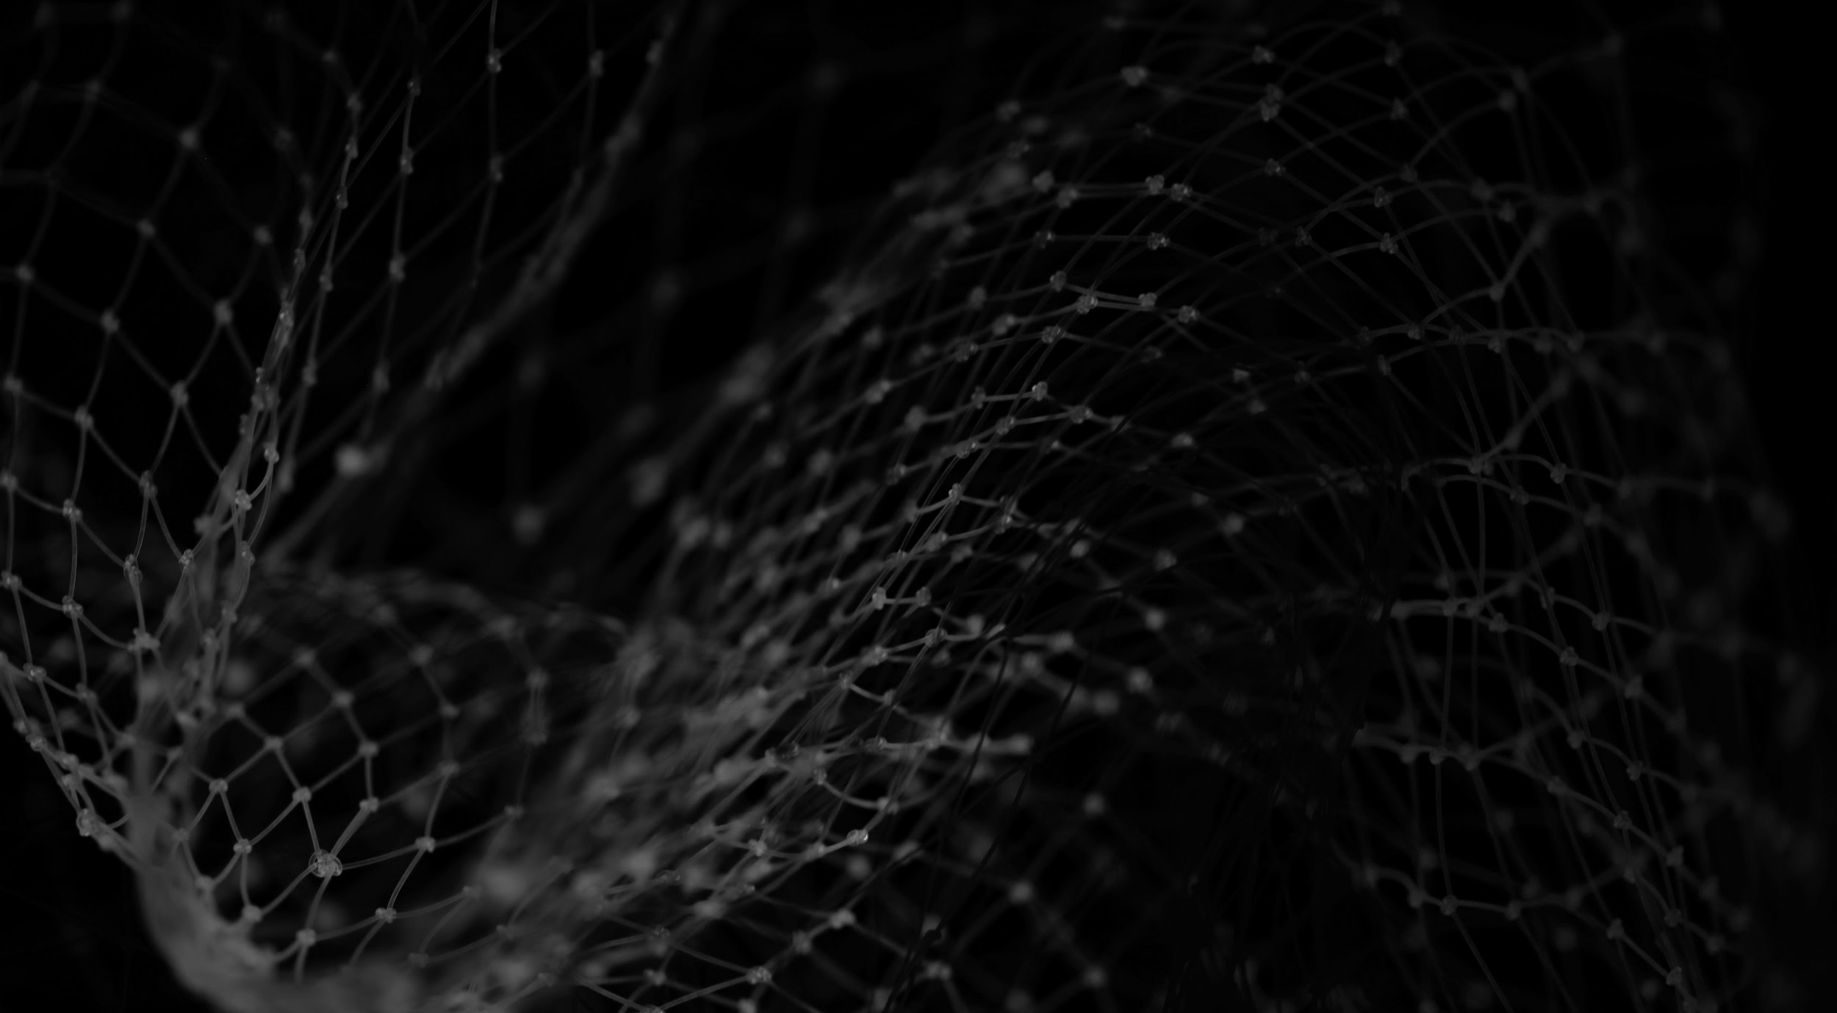
TERMINOLOGY
DIGITAL HARM
Any harm received by
a digital twin.
TheIOFoundation.org | Contact@TheIOFoundation | Join.TheIOFoundation.org
Notes:
If we equiparate our data to ourselves then the definition could be similar: A harm is caused/inflicted when a Right is not observed.
Ultimate Harm = Data destruction? Or is it

Slide 22
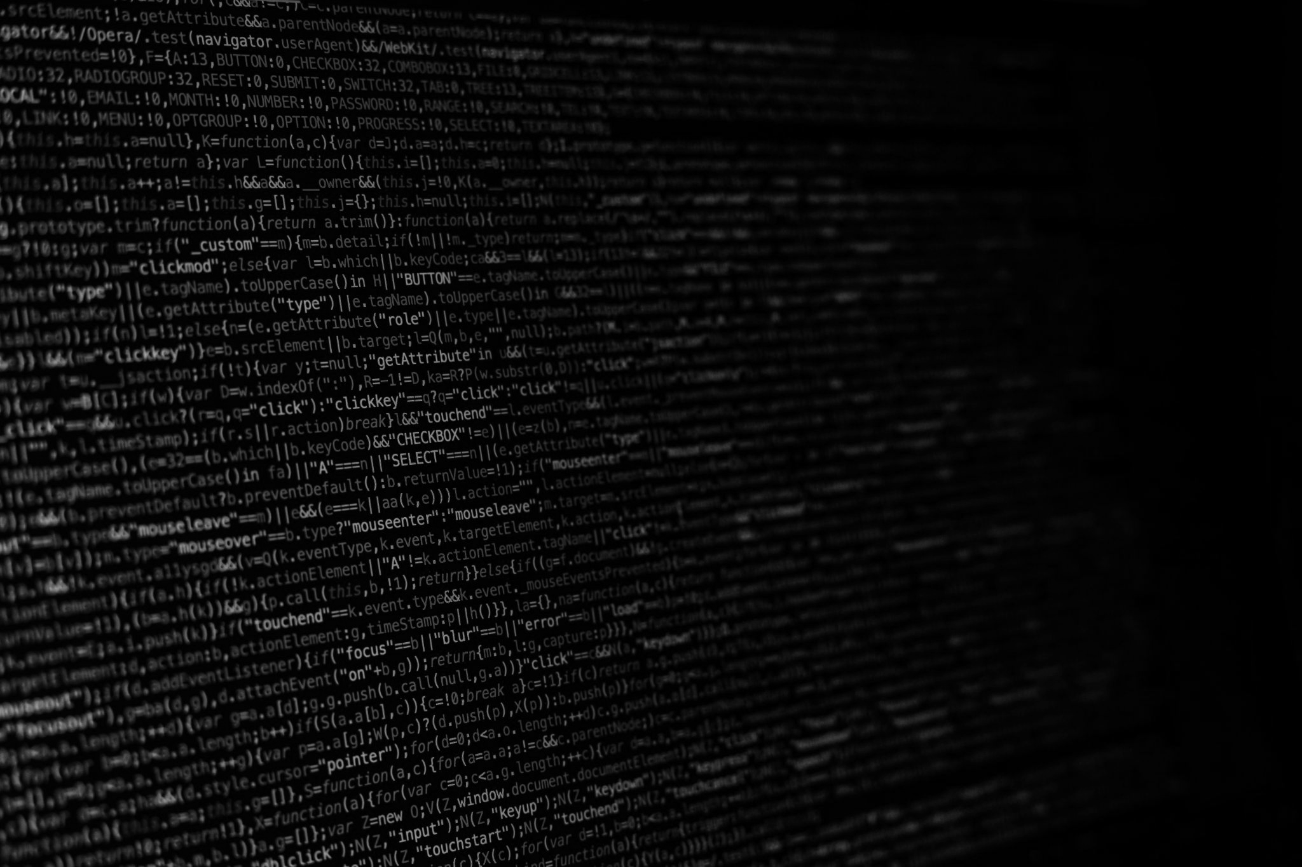
THE A3 MODEL
AUTHENTICITY
ACCURACY
AGENCY
TheIOFoundation.org | Contact@TheIOFoundation | Join.TheIOFoundation.org

Slide 23
RIGHTS vs ETHICS
RIGHTS
ETHICS
TheIOFoundation.org | Contact@TheIOFoundation | Join.TheIOFoundation.org
Notes:
What do we need to make them be the NEXTGEN?

Slide 24
HARMS MATRIX
PHYSICAL
SPACE
ENTITY A
DT
A
DIGITAL
SPACE
ENTITY B
DT
B
PHYSICAL HARMS
DIGITAL
HARMS
TheIOFoundation.org | Contact@TheIOFoundation | Join.TheIOFoundation.org
Notes:
THE WHY

Slide 25



DCDR PRINCIPLES
PRINCIPLE I
PRINCIPLE II
PRINCIPLE III
STATUS: READY
TheIOFoundation.org | Contact@TheIOFoundation | Join.TheIOFoundation.org

Slide 26



DCDR STRUCTURAL LAYERS
LAYER III
LAYER II
LAYER I
TheIOFoundation.org | Contact@TheIOFoundation | Join.TheIOFoundation.org

Slide 27



DCDR TAXONOMIES (LAYER II)
DIGITAL HARMS
DIGITAL RIGHTS
USE CASES
TheIOFoundation.org | Contact@TheIOFoundation | Join.TheIOFoundation.org

Slide 28



SAGAN OATH
BONUS
HEY BIG TECH! declaration
STATUS: READY
TheIOFoundation.org | Contact@TheIOFoundation | Join.TheIOFoundation.org

Slide 29
PART III
APPLICATIONS OF DCDR
TheIOFoundation.org | Contact@TheIOFoundation | Join.TheIOFoundation.org

Slide 30
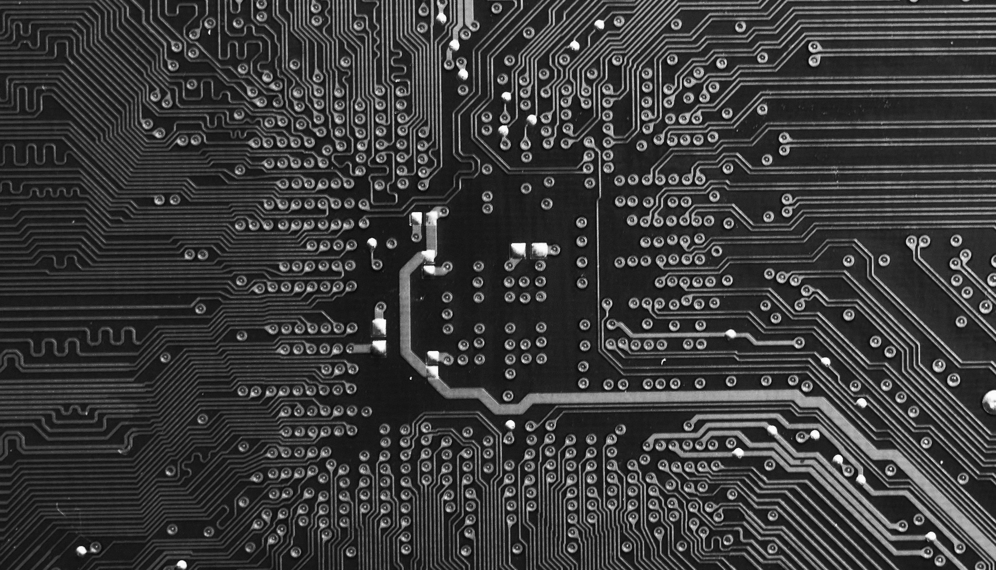
THE IDEAL
DR SDK
TheIOFoundation.org | Contact@TheIOFoundation | Join.TheIOFoundation.org

Slide 31
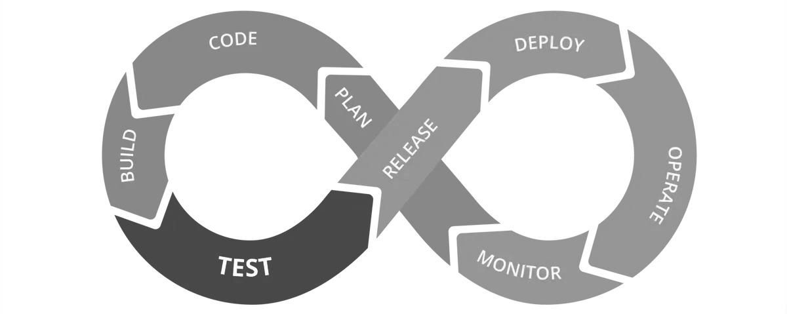
UPGRADING CI/CD PIPELINES
TheIOFoundation.org | Contact@TheIOFoundation | Join.TheIOFoundation.org

Slide 32
CONNECTING IG & DCDR
Analyzing policy
Internet Freedom
Countering Internet Fragmentation
Mal/Mis/Disinformation
TheIOFoundation.org | Contact@TheIOFoundation | Join.TheIOFoundation.org

Slide 33
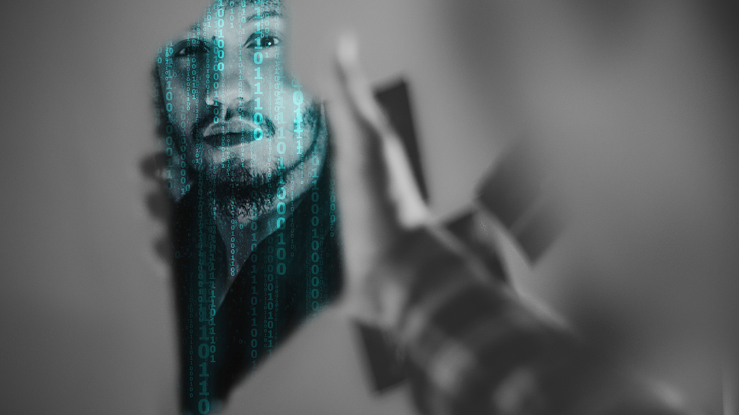
In what kind of
Digital World
Do you want to
EXIST?
TheIOFoundation.org | Contact@TheIOFoundation | Join.TheIOFoundation.org

Slide 34
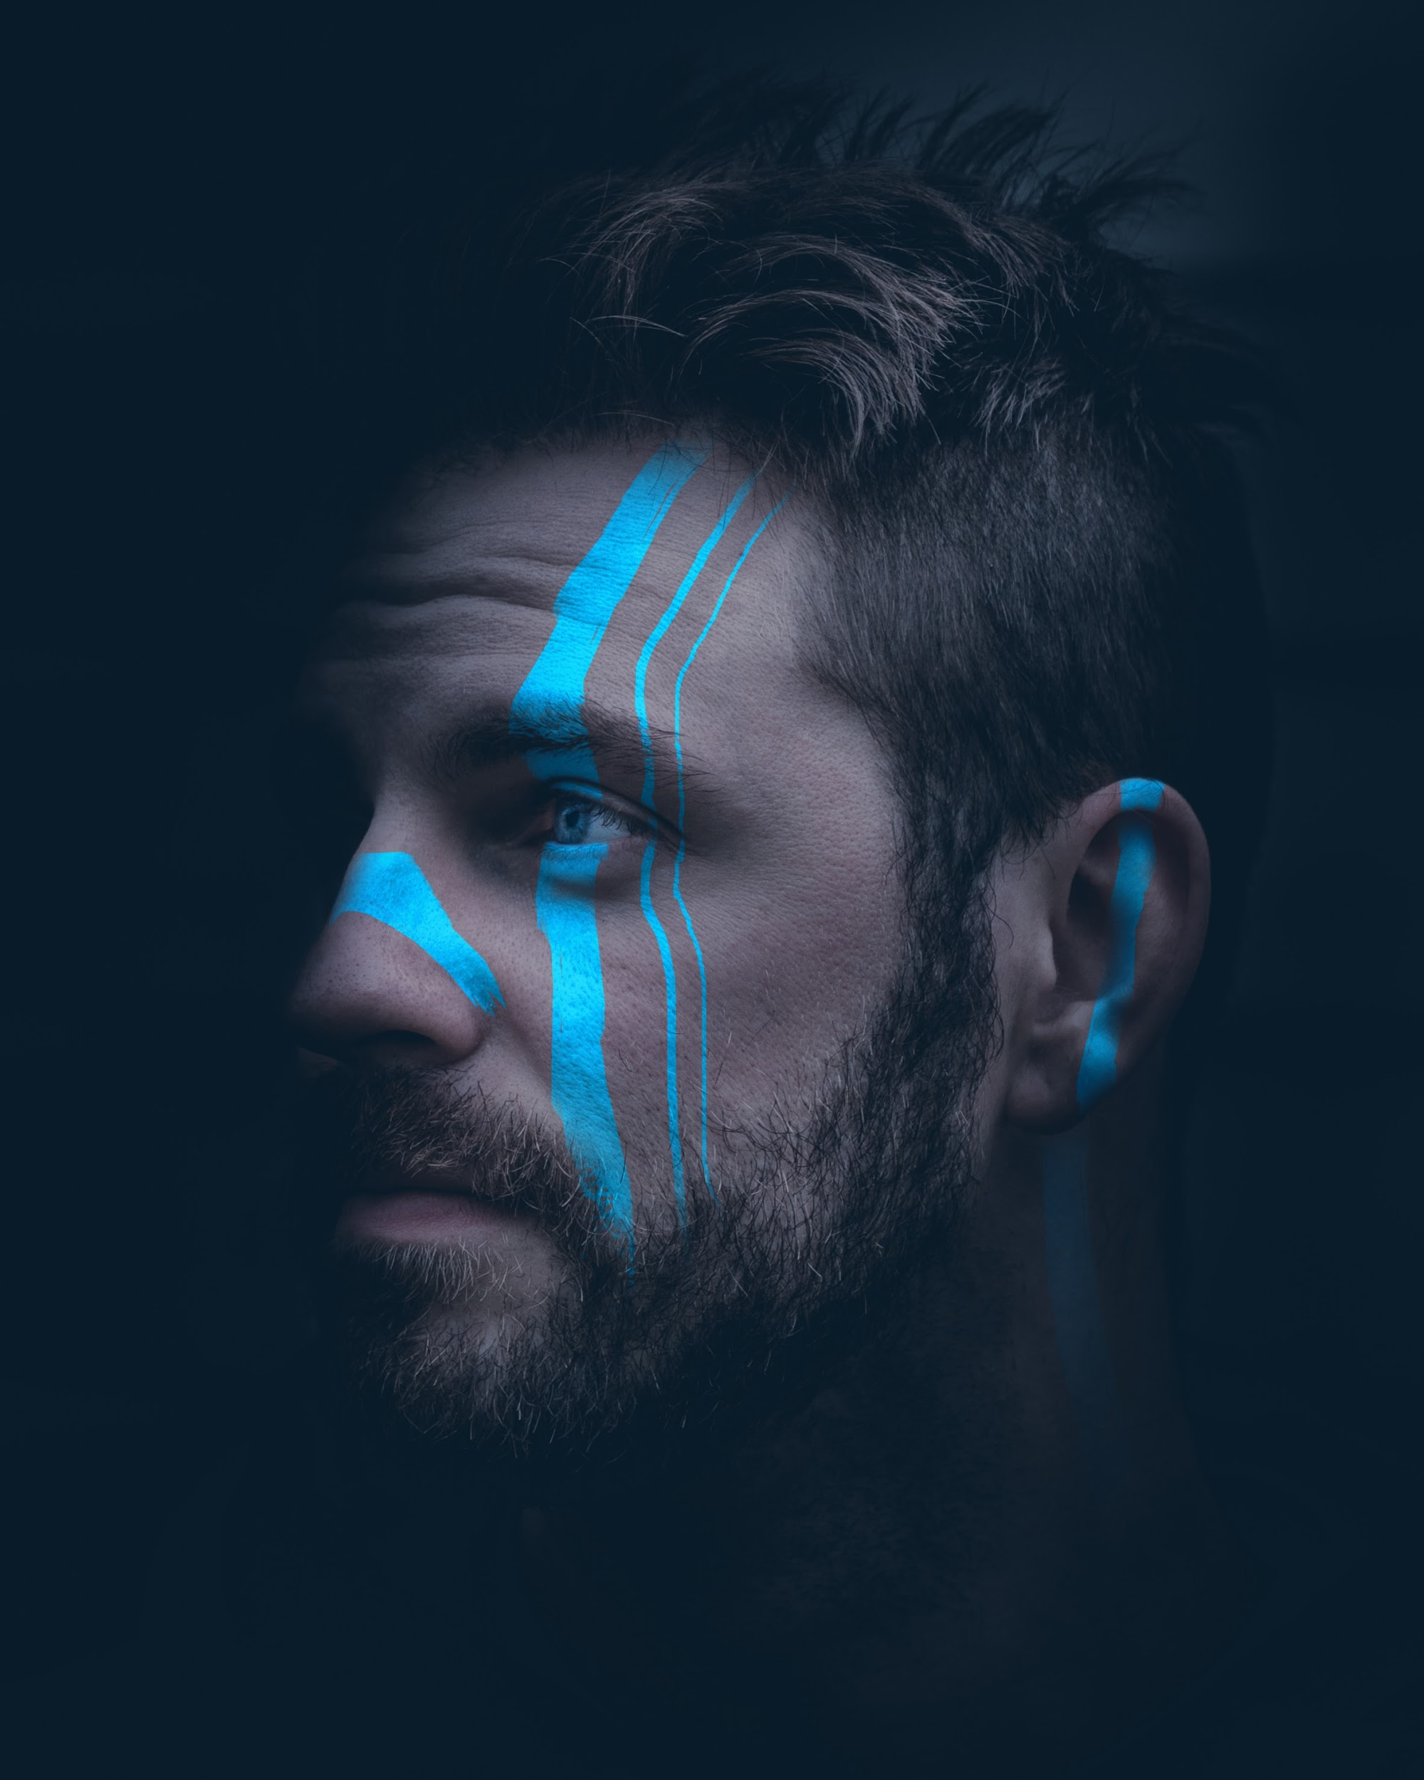
We the people
We the cyborgs
TheIOFoundation.org | Contact@TheIOFoundation | Join.TheIOFoundation.org

Slide 35

Q&A
THE ONLY USELESS QUESTION
IS THE ONE YOU DON’T ASK
TheIOFoundation.org | Contact@TheIOFoundation | Join.TheIOFoundation.org
Notes:
REFERENCE Media Kit | Slides Repo | Talking Points (FAQ)
Template Content A
Usage

Slide 36

TheIOFoundation.org | Contact@TheIOFoundation | Join.TheIOFoundation.org

Slide 37








CONTACT US
The IO Foundation, a global for-impact NGO advocating for Data-Centric Digital Rights (DCDR)
EMAIL US
SUPPORT US
FOLLOW US
Image credits: Unsplash - Pixabay - Burst
Notes:
Contact The IO Foundation
Website https://TheIOFoundation.org
Join TIOF https://TIOF.Click/JoinUs
Github repository https://TIOF.Click/TIOFRepo
Linkedin https://TIOF.Click/TIOFLinkedIn
Twitter https://TIOF.Click/TIOFTwitter
Summary of links https://TIOF.Click/AboutUs
Media Kit https://TIOF.Click/TIOFMediaKit

